Slide 1


http://www.comp.nus.edu.sg/~cs2100/
Recitation 2
Pointers, functions, arrays and structures

Slide 2
Agenda
Quick 5 minute summary.
Solutions to Rec2 Quizzes
Sli.Do Questions
Extra Questions

Slide 3
summary
Pointers

Slide 4
1. Pointers (3/3)
You may refer to the address of a variable by using the address operator & (ampersand)
Address.c
int a = 123;
printf("a = %d\n", a);
printf("&a = %p\n", &a);
a = 123
&a = ffbff7dc
%p is used as the format specifier for addresses
Addresses are printed out in hexadecimal (base 16) format
The address of a variable varies from run to run, as the system allocates any free memory to the variable

Slide 5
1.1 Pointer Variable
A variable that contains the address of another variable is called a pointer variable, or simply, a pointer.
Example: a pointer variable a_ptr is shown as a blue box below. It contains the address of variable a.
a_ptr
a
Assuming that variable a is located at address ffbff7dc.
ffbff7dc
123
Variable a_ptr is said to be pointing to variable a.
If the address of a is immaterial, we simply draw an arrow from the blue box to the variable it points to.
a_ptr
a
123

Slide 6
1.4 Accessing Variable Through Pointer
a_ptr
a
123
Once we make a_ptr points to a (as shown above), we can now access a directly as usual, or indirectly through a_ptr by using the indirection operator (also called dereferencing operator) *
printf("a = %d\n", *a_ptr);
≡
printf("a = %d\n", a);
*a_ptr = 456;
≡
a = 456;
Hence, *a_ptr is synonymous with a

Slide 7
summary
Pointer Arithmetic

Slide 8
1.8 Incrementing a Pointer
If p is a pointer variable, what does p = p + 1 (or p++) mean?
Recall Lect#2a slide 16:
int takes up 4 bytes
float takes up 4 bytes
char takes up 1 byte
double takes up 8 bytes
int a; float b; char c; double d;
int *ap; float *bp;
char *cp; double *dp;
ap = &a; bp = &b; cp = &c; dp = &d;
printf("%p %p %p %p\n", ap, bp, cp, dp);
ap++; bp++; cp++; dp++;
printf("%p %p %p %p\n", ap, bp, cp, dp);
ap += 3;
printf("%p\n", ap);
ffbff0a4 ffbff0a0 ffbff09f ffbff090
+4
+4
+1
+8
ffbff0a8 ffbff0a4 ffbff0a0 ffbff098
+12
ffbff0b4
IncrementPointers.c

Slide 9
summary
Pass By Value vs Pass By Pointer

Slide 10
4.1 Consequence of Pass-by-Value
Can this code be used to swap the values in a and b?
In main, before: a=2, b=3
#include <stdio.h>
void swap(int, int);
int main(void) {
int a = 2, b = 3;
printf("In main, before: a=%d, b=%d\n", a, b);
swap(a, b);
printf("In main, after : a=%d, b=%d\n", a, b); return 0;
}
void swap(int a, int b) {
int temp = a;
a = b;
b = temp;
}
In main, after : a=2, b=3
No
SwapIncorrect.c
❖

Slide 11
5.1 Function To Swap Two Variables
3
2
#include <stdio.h>
void swap(int *, int *);
int main(void) {
int a, b;
printf("Enter two integers: ");
scanf("%d %d", &var1, &var2);
swap( &a, &b );
printf("var1 = %d; var2 = %d\n", var1, var2);
return 0;
}
void swap(int *ptr1, int *ptr2) {
int temp;
temp = *ptr1; *ptr1 = *ptr2; *ptr2 = temp;
}
In main():
a
2
b
3
In swap():
ptr1
ptr2
SwapCorrect.c

Slide 12
summary
Arrays and Pointers

Slide 13
2.2 Arrays and Pointers
Example: int a[10]
a[0]
a[1]
a[2]
a[3]
a[4]
a[5]
a[6]
a[7]
a[8]
a[9]
When the array name a appears in an expression, it refers to the address of the first element (i.e. &a[0]) of that array.
int a[3];
printf("%p\n", a);
printf("%p\n", &a[0]);
printf("%p\n", &a[1]);
These 2 outputs will always be the same.
ffbff724
ffbff724
ffbff728
Output varies from one run to another. Each element is of int type, hence takes up 4 bytes (32 bits).

Slide 14
2.3 Array Assignment (1/2)
The following is illegal in C:
ArrayAssignment.c
#define N 10
int source[N] = { 10, 20, 30, 40, 50 };
int dest[N];
dest = source; // illegal!
source[0]
source[9]
10
20
30
40
50
0
0
0
0
0
dest[0]
dest[9]
?
?
?
?
?
?
?
?
?
?
Reason:
An array name is a fixed (constant) pointer; it points to the first element of the array, and this cannot be altered.
The code above attempts to alter dest to make it point elsewhere.

Slide 15
summary
Structures

Slide 16
4.3 Initializing Structure Variables
The syntax is like array initialization
Examples:
typedef struct {
int day, month, year;
} date_t;
typedef struct {
int cardNum;
date_t expiryDate;
} card_t;
card_t card1 = {888888, {31, 12, 2020}};
typedef struct {
int stuNum;
float score;
char grade;
} result_t;
result_t result1 = { 123321, 93.5, 'A' };

Slide 17
quizzes

Slide 18
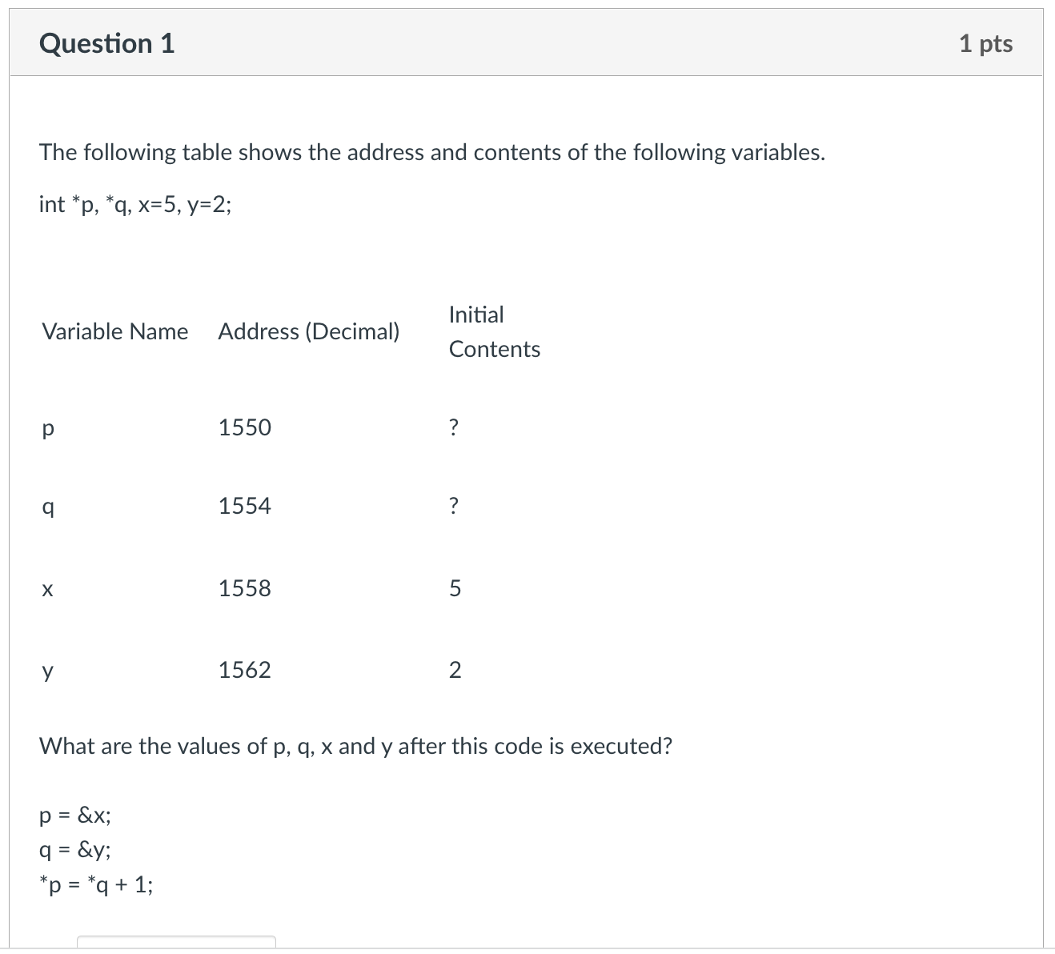
Pointers and Functions Quiz 1

Slide 19
Pointers and Functions Quiz 1
p
q
5
3
2
x
y

Slide 20
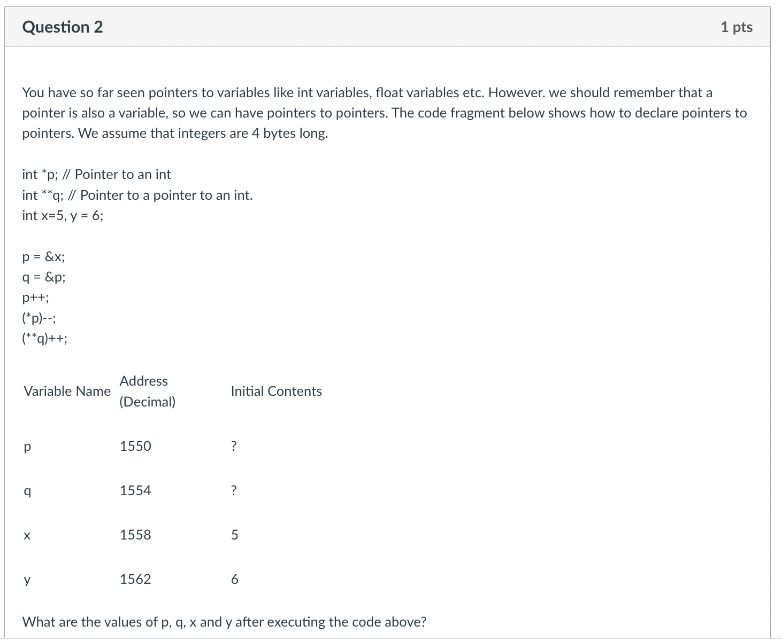
Pointers and Functions Quiz 1

Slide 21
Pointers and Functions Quiz 1
p
q
6
5
5
6
x
y

Slide 22
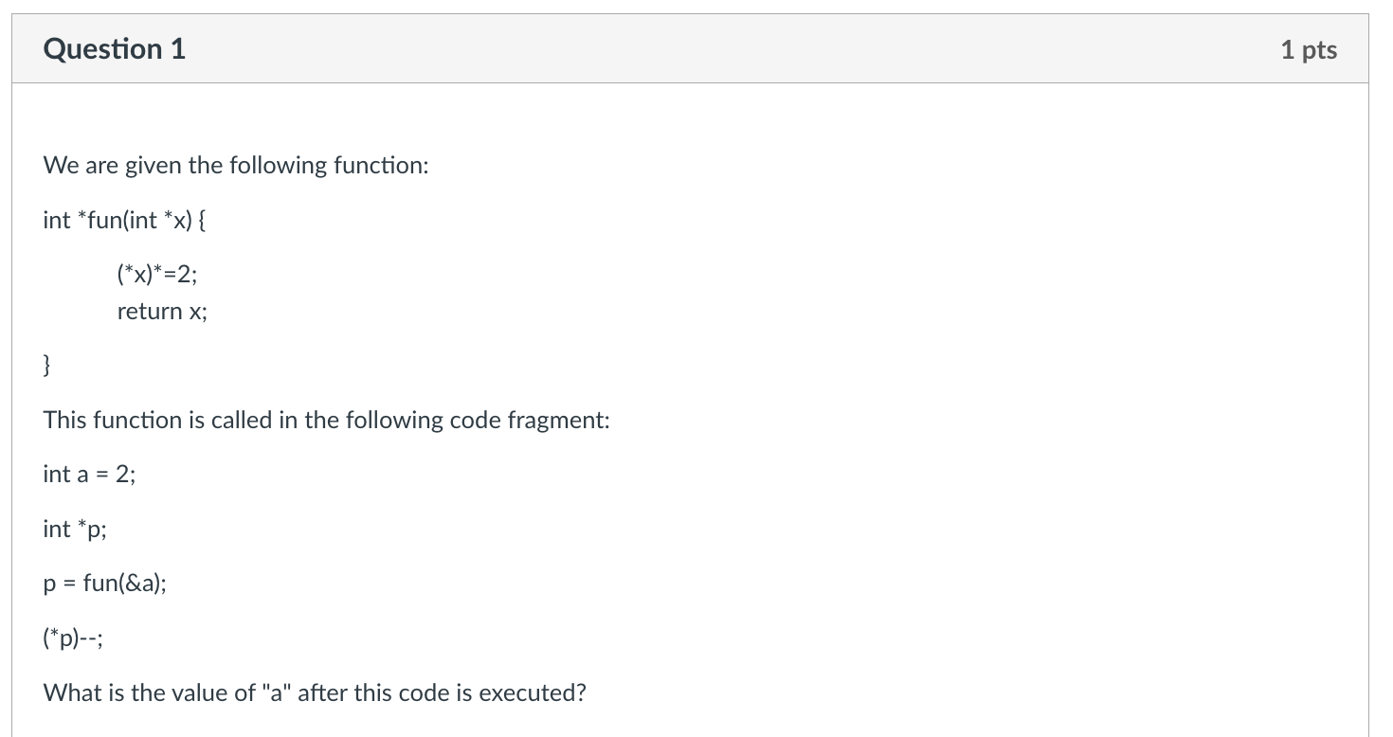
Pointers and Functions Quiz 2

Slide 23
Pointers and Functions Quiz 2
a
p
2
4
3
x

Slide 24
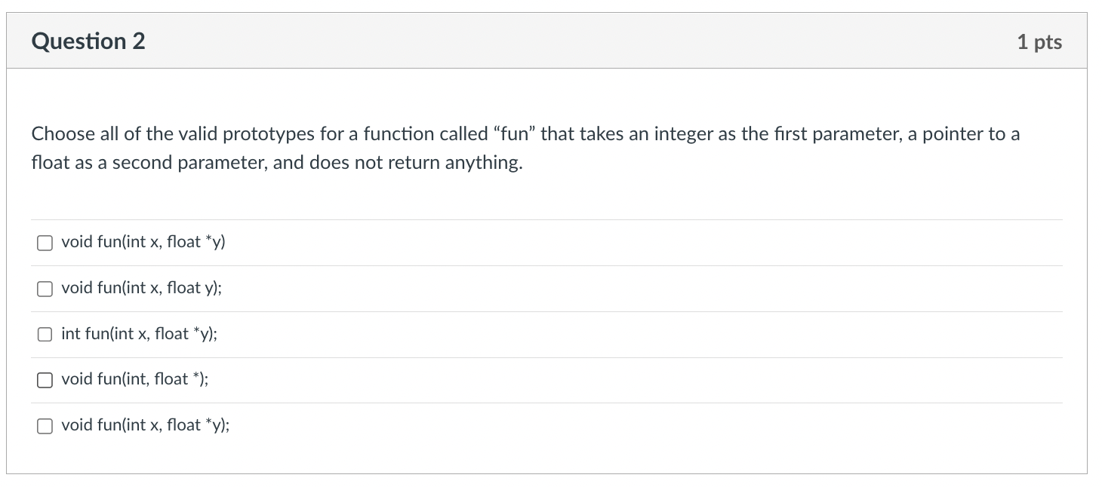
Pointers and Functions Quiz 2

Slide 25
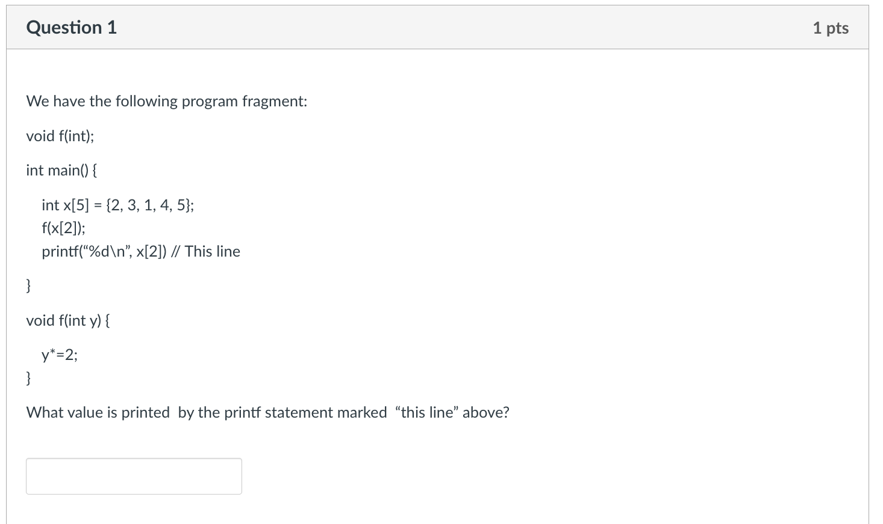
Arrays, Strings and Structures Quiz 1

Slide 26
Arrays, Strings and Structures Quiz 1
X[0]
X[1]
X[2]
X[3]
X[4]
2
3
1
4
5
1
2
y

Slide 27
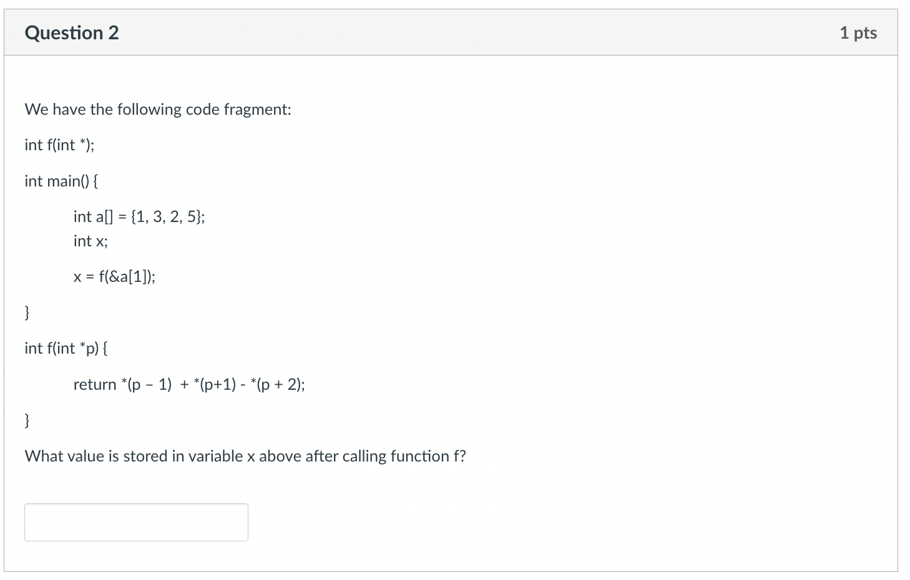
Arrays, Strings and Structures Quiz 1

Slide 28
Arrays, Strings and Structures Quiz 1

Slide 29
Arrays, Strings and Structures Quiz 1
a[0]
a[1]
a[2]
a[3]
1
3
2
5
p
*(p - 1) = 1
*(p + 1) = 2
*(p + 2) = 5
*(p – 1) + *(p + 1) - *(p + 2)
1 + 2 – 5 = -2

Slide 30
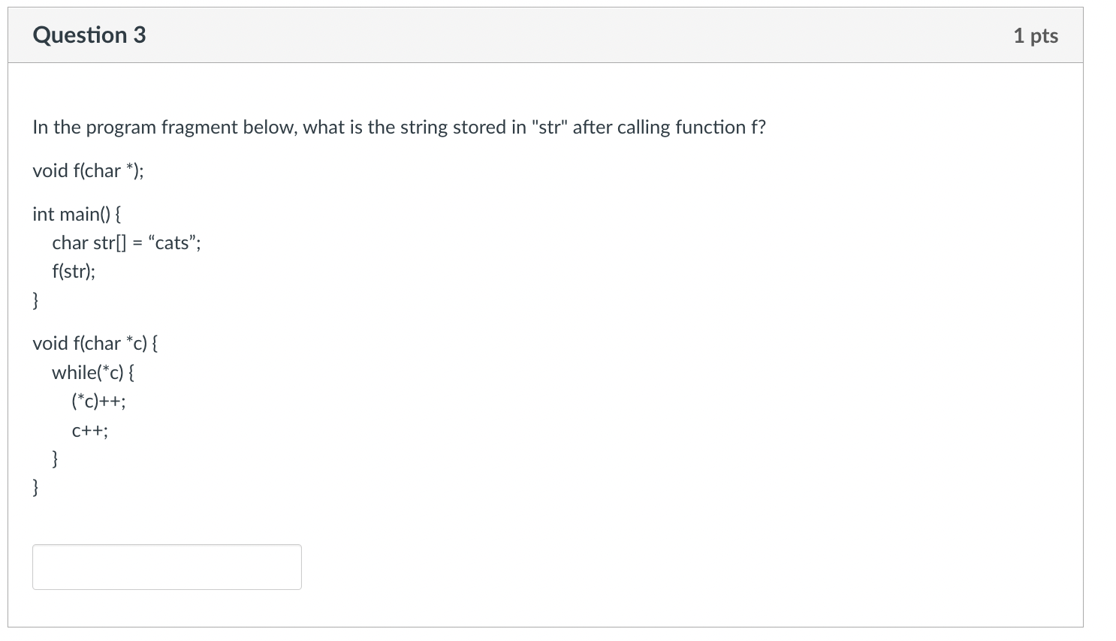
Arrays, Strings and Structures Quiz 1

Slide 31
Arrays, Strings and Structures Quiz 1
str[0]
str[1]
str[2]
str[3]
str[4]
c
d
b
a
u
t
t
s
\0
c

Slide 32
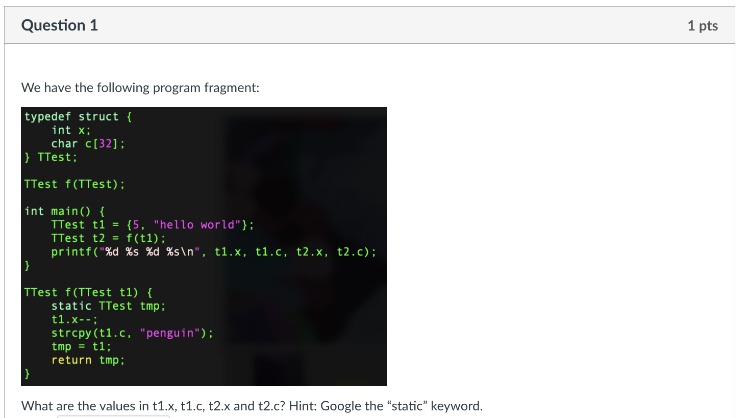
Arrays, Strings and Structures Quiz 2
x
c
t1
5
hello world
x
c
t1
4
5
penguin
hello world
x
c
tmp
4
penguin
x
c
t2
4
penguin
t1.x=5, t1.c=“hello world”
t2.x=4, t2.c=“penguin”

Slide 33
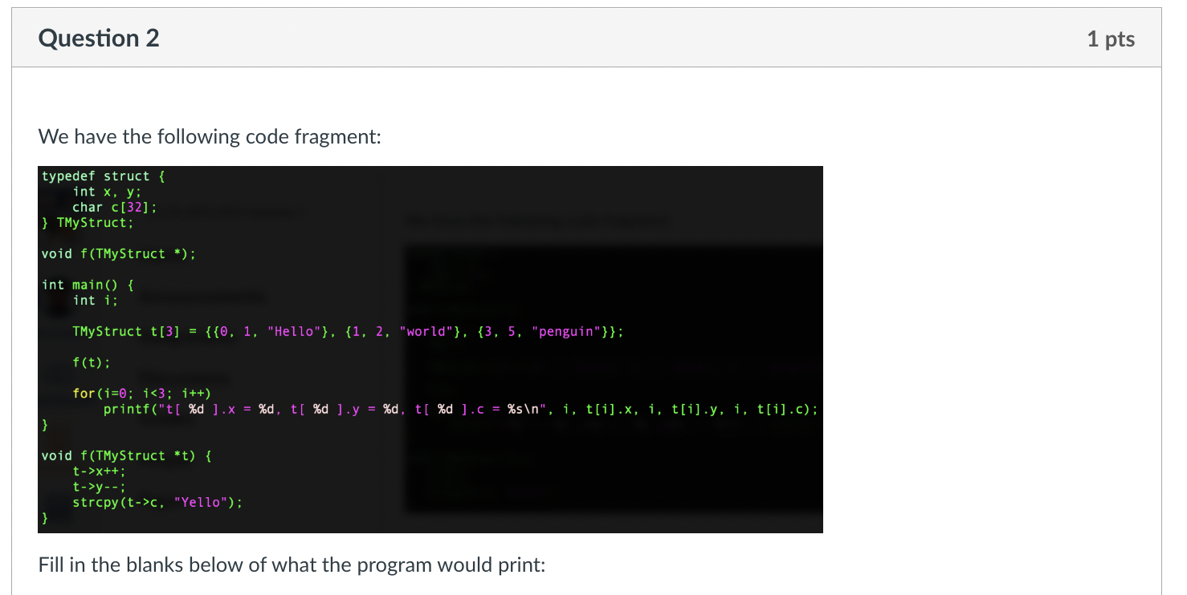
Arrays, Strings and Structures Quiz 2

Slide 34
Arrays, Strings and Structures Quiz 2
t[0]
t[1]
t[2]
0, 1, “hello”
0,0, “yello”
1, 2, “world”
3, 5, “penguin”
t
t[0].x=0, t[0].y=0, t[0].c=“yello”
t[1].x=1, t[1].y=2, t[1].c=“world”
t[2].x=3, t[2].y=5, t[2].c=“penguin”

Slide 35
Sli.do questions

Slide 36
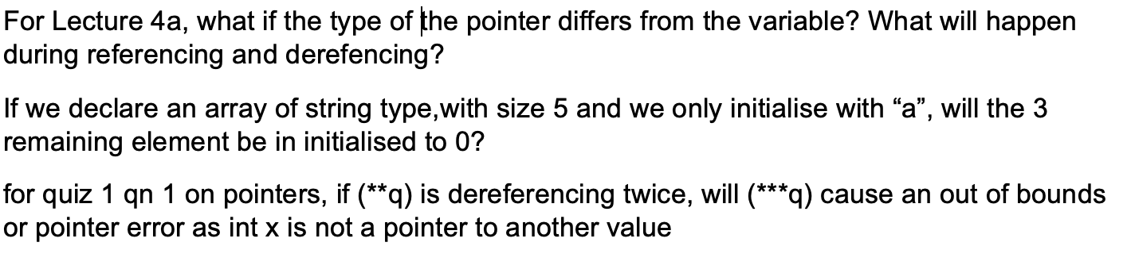
Try On Your Own

Slide 37
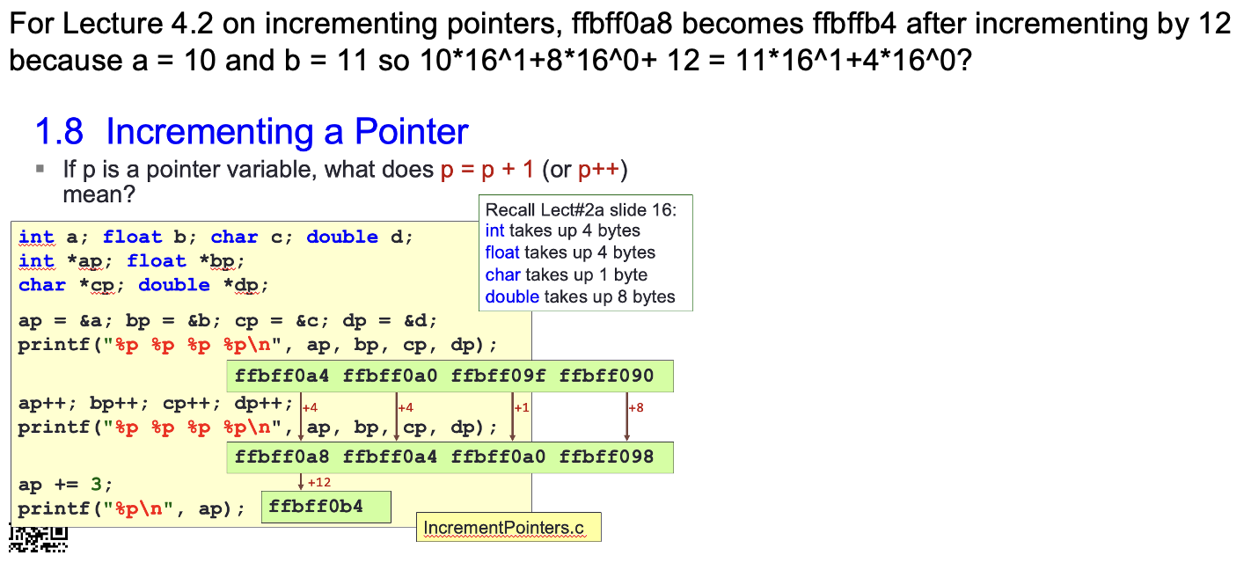
Pointers

Slide 38
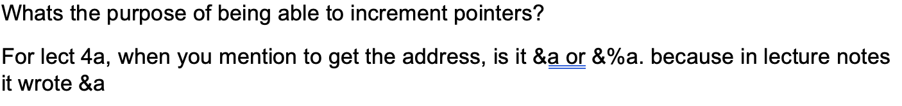
Pointers

Slide 39
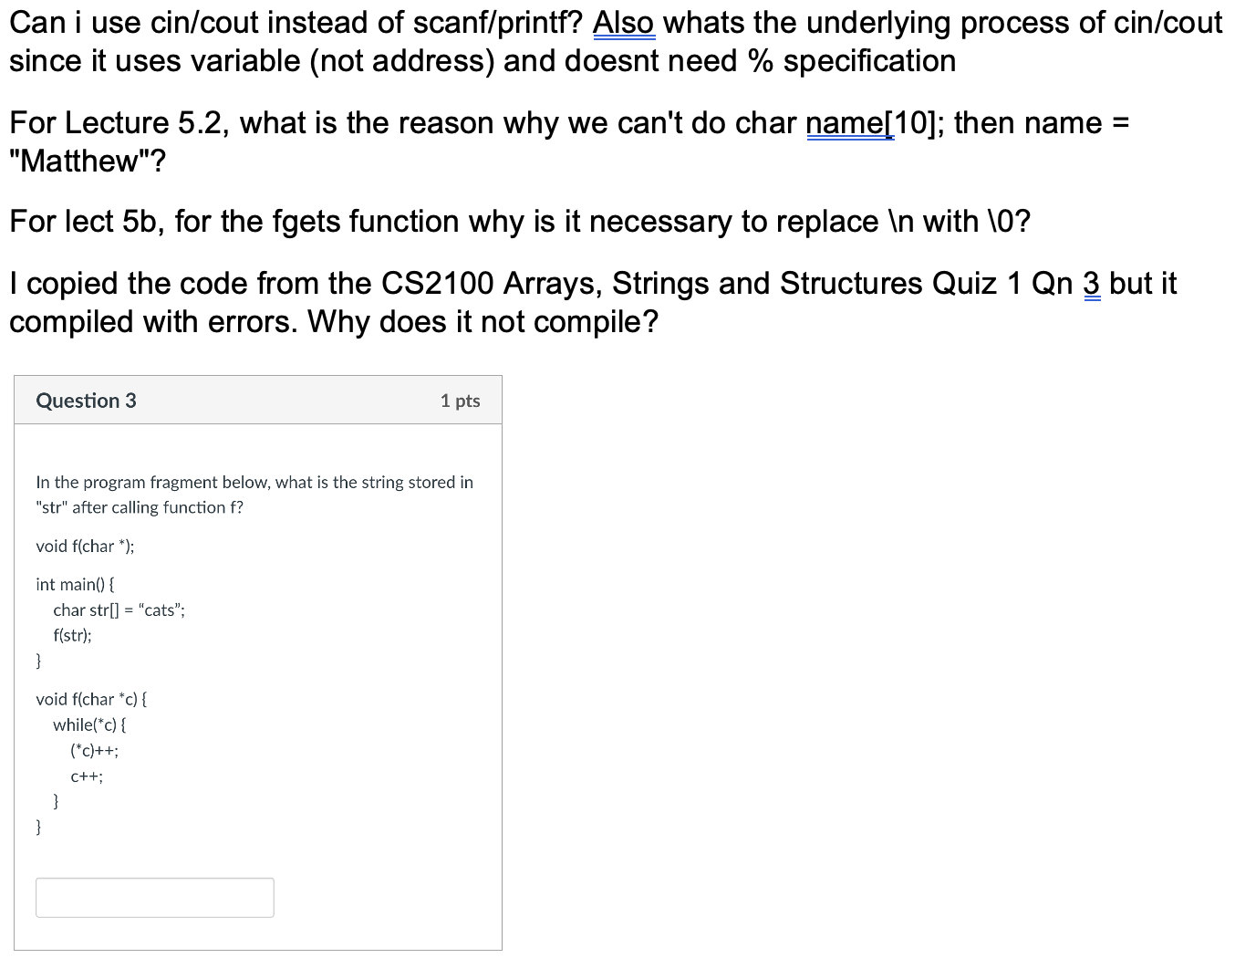
C Programming (Strings, Structures)

Slide 40
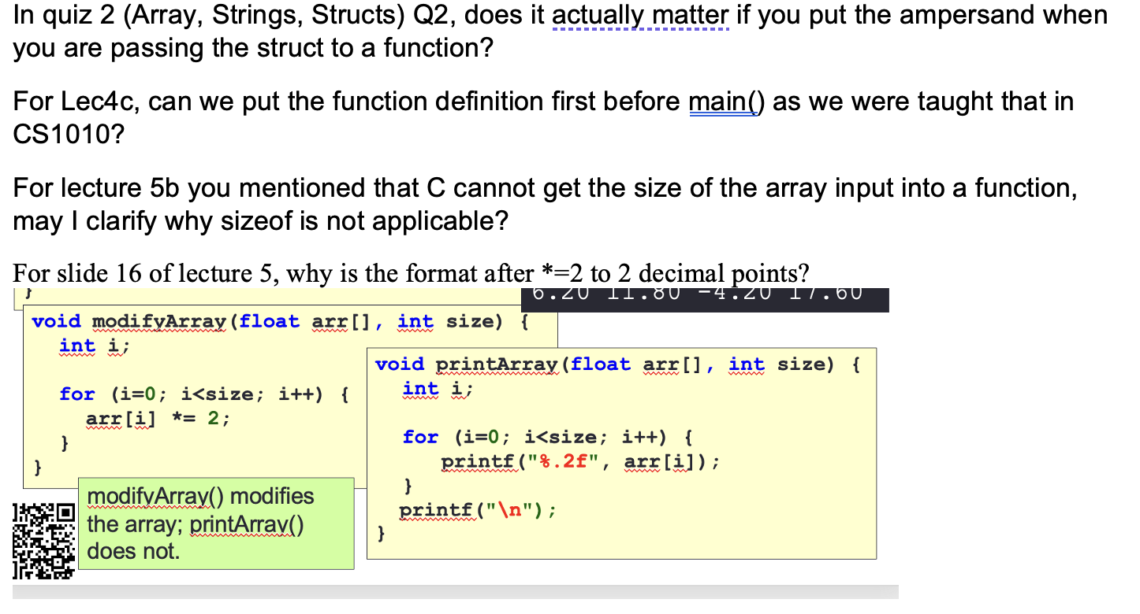
C Programming (Strings, Structures)

Slide 41
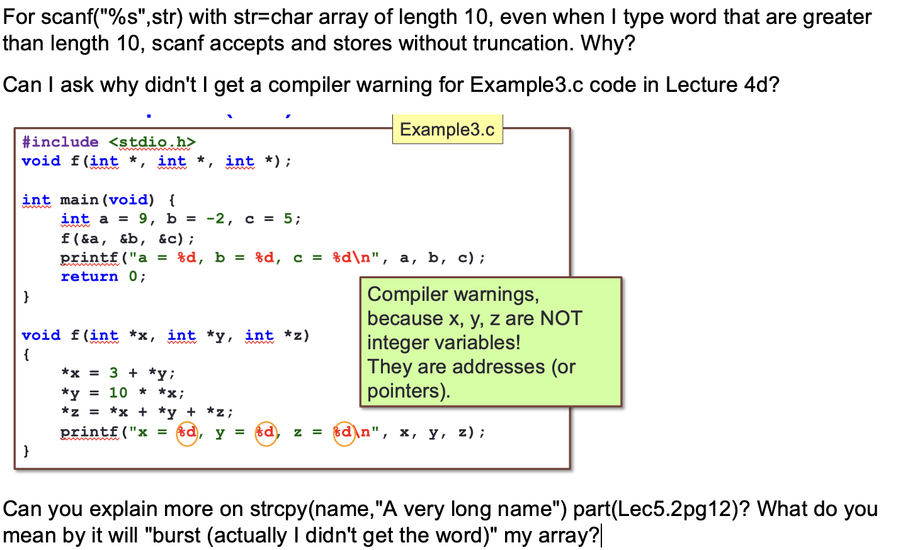
C Programming (Strings, Structures)

Slide 42
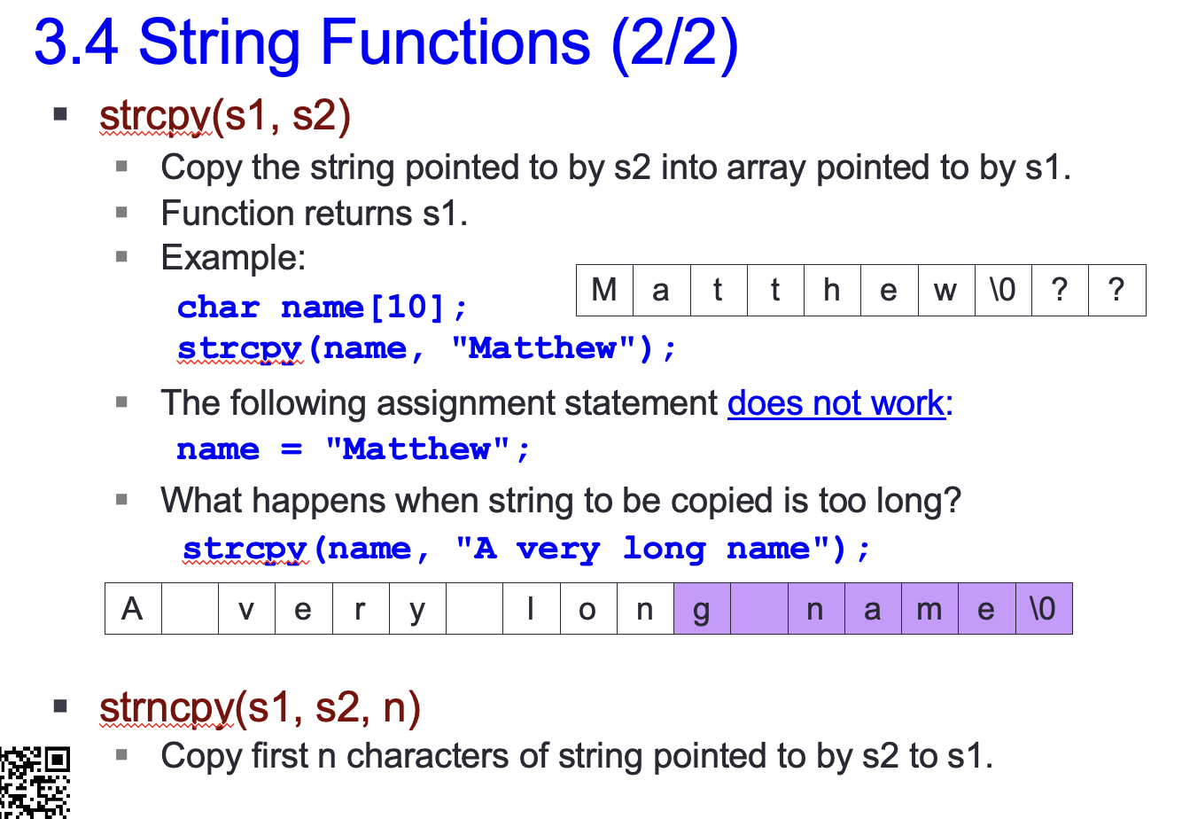
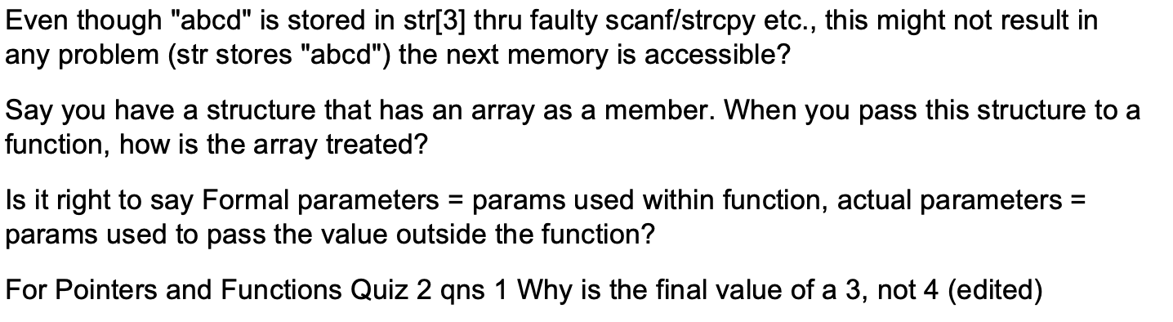
C Programming (Strings, Structures)

Slide 43
extra exercises

Slide 44
Extra Exercises Exercise 1 – Palindrome Checker 1
A palindrome is a series of characters that reads the same way from left to right and right to left.
Examples: level, rotor, kayak, Able was I I saw Elba
Notice that capitalization does not matter.
Write a palindrome checker in C that:
Reads in a string from the user (may contain spaces and mixed capitalization)
Prints “YES it is a palindrome” if the input string is a palindrome, or “NO it is not a palindrome” otherwise.
Use array indexes to solve this problem.

Slide 45
Extra Exercises Exercise 2 – Palindrome Checker 2
Solve Exercise 1 using only pointers and pointer arithmetic.

Slide 46
End of File

